Slide 1
Object pronouns
Basic 5 – Unit 2 Lesson B

Slide 2
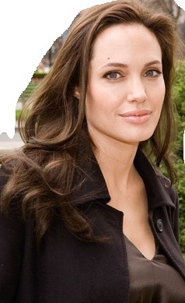
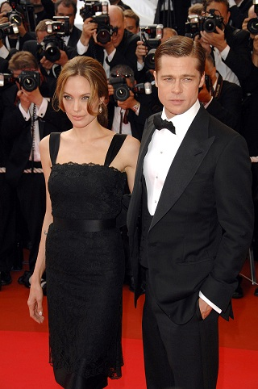
Object pronouns are pronouns that receive the action. They don’t do the action
I like Angelina Jolie a lot. She is my favorite actress. I like ______ a lot.
her
Angelina Jolie and Brad Pitt are two of my favorite actors. They are good actors. I like ______ a lot.
them

Slide 3
Object Pronouns in English
Angelina is walking with Brad Pitt.
Subject
Object
him
She is walking with .
Subject
Object
Luis and Juan like Angelina Jolie a lot.
Subject
Object
her
They like ______ a lot.
I can give you and mike some cookies.
Subject
Object
you
I can give ______ some cookies.
Subject
Object

Slide 4
Bob and I know Mel and Andy very well. ____ know ____ very well.
You and Debra look like your parents. ____ look like ___.
Tom looks like your aunt Peggy. _____ looks like _______.
Ann visits Betty often. _______ visits ______ often.
Betty makes coffee for the guests. ___makes coffee for____.
Colin waits for Andy after school. ______ waits for ________ after school.
Andy is coming with you and me. ____ is coming with ____.
Paula has a good grade on her math test. ______ studied for _____.

Slide 5
Anne is taking her books to the library. She is carrying (they, them)
He is writing a song for (she, her).
Betty is staying home and (she , her) is getting some rest.
Ann foot hurts when (she, her) walks.
Anna's mom says (she, her) is disorganized
Helen is making a blue sweater for (she, her)
Jan is not at work today because she is here with (I, me)

